Slide 1
Post MD Training DO s and DO Nots
Dr Pathum Dissanayake
Lecturer in Paediatrics
Department of Paediatrics
Faculty of medicine
University of Peradeniya

Slide 2
1st month
Arrive in UK at least 1 week before appointment
housing, transport, shops......
Orientation week – No Pay.... But worth doing
Familiarize with medical staffing unit
- extremely important
- salary issues
- official letters
- locum shifts

Slide 3
1st month contd....
Occupational health unit
Get clearance by showing detailed documentation regarding vaccines/ Ab status etc.
esp... if working in neonates
Register at RCPCH for an ePortfolio
automatically included if going through the MTIP
Register for ASSET website
For miniCEX, CBD, DOPS

Slide 4
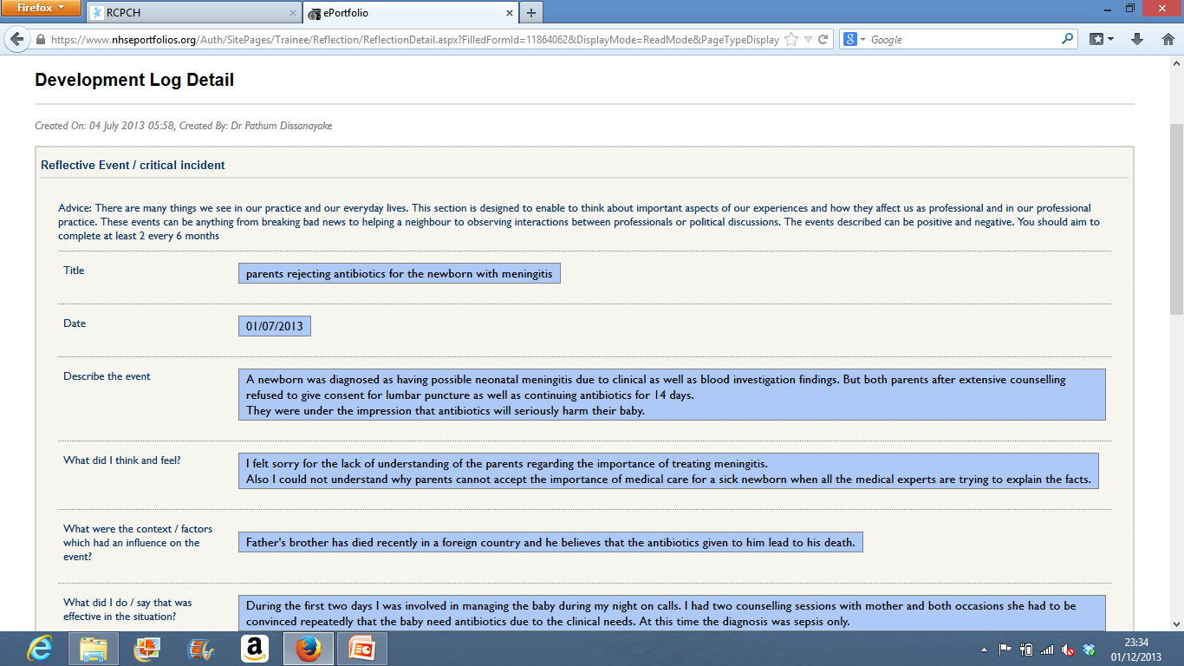
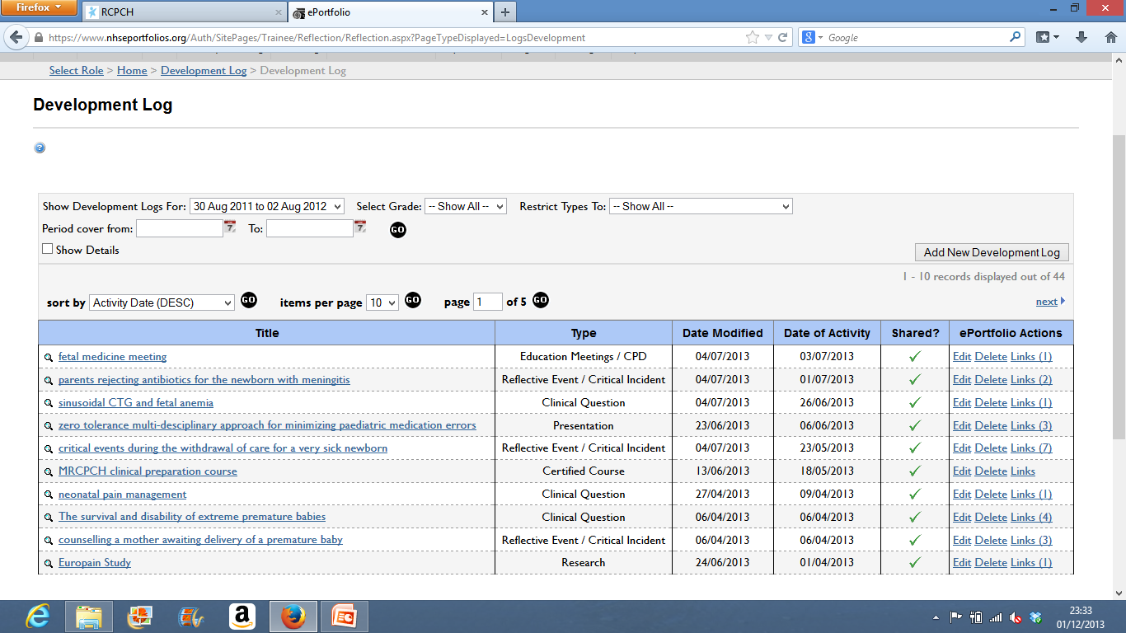
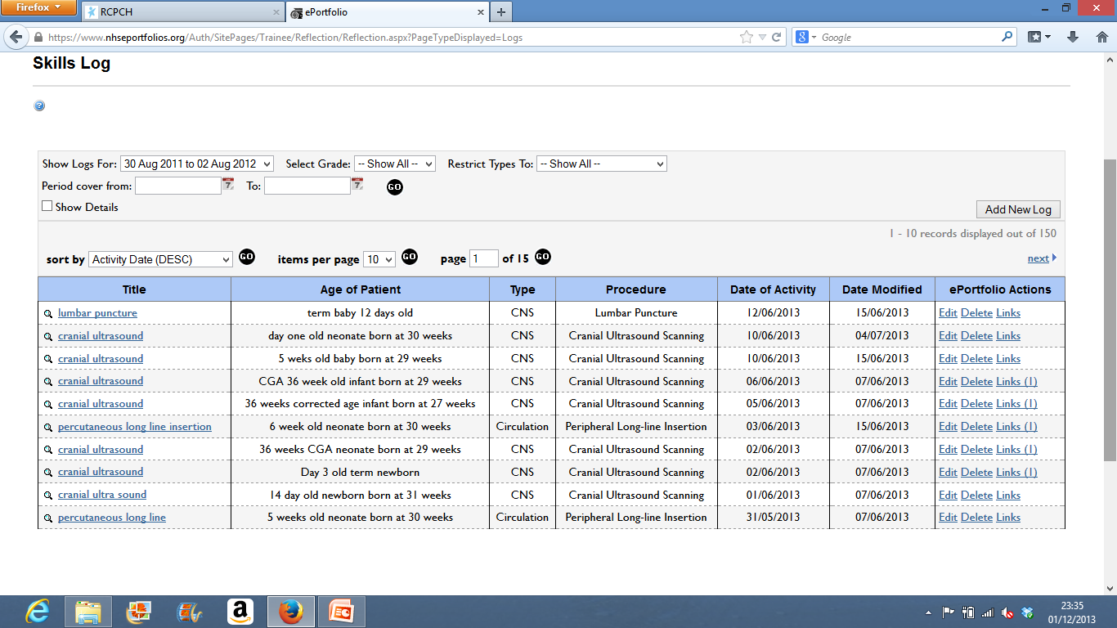
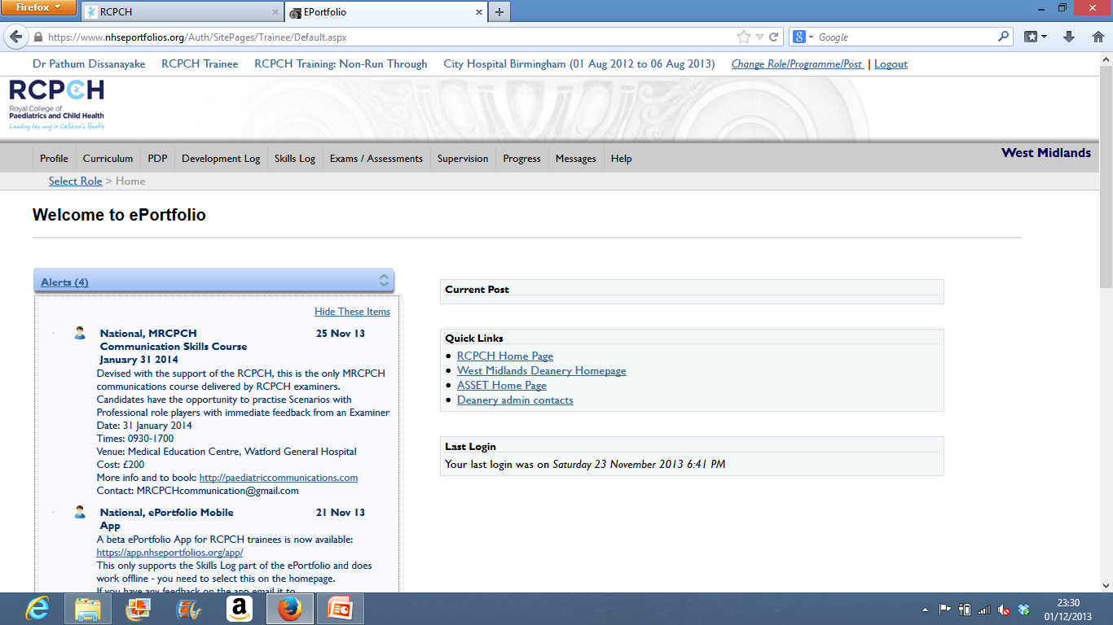

Slide 6
conduct
Dress code
Bare below elbows
No ties/ necklace / bangles/wrist watches
When entering and exiting wards
Use HAND WASH !!!!
Do not speak in Sinhalese if you have a fellow Sri Lankan working with you
“Sir”, “Madam” – non existing
Either use first name or use Dr. Surname
Actively participate during clinical sessions
Do not play the “passive listener” role

Slide 7
1st Three months
Attend handovers and observe handing over procedure
Observe communication scenarios – plenty
Start mandatory training sessions
mandatory for UK trainees BUT worth attending
conflict resolution/ clinical governance/ fire training/ health and safety etc...
FREE courses – a rarity in UK

Slide 8
Do not refuse swaps in shift work (initially)
A sure way of becoming popular among colleagues
Attend clinics even if you are just an observer.
The best way to learn the trade of “communication”
Do practical procedures as much as possible
If you aim for a middle grade job – a must...

Slide 9
Middle grade job
Better to have some training as a SHO before applying for a middle grade job
Improve skills in decision making
Attend child safe guarding workshops
Level 1 – 3 (some can be done online in the RCPCH website)
Dictating in clinics ( an alien thing to us but easy to master)
Communication with patients and staff should be at a higher level
Learn about local trust policies (admission criteria/ referral process etc)

Slide 10
Tackling the nurses
Get friendly with the ward manager
Learn the names fast
Use lot of “Thank you”s and “may I”
Do not give orders – a fatal error!!!!
respect their opinions – some are valuable
Open doors to staff & be curteous

Slide 11
First 6 months
Aim to do audits / surveys / case reports
Very easy as records are well kept
Plenty of support
Plenty of options to get them presented.
Aim for a middle grade job
Being a SHO for a whole year is useless
You can earn but not learn
Try to attend international courses/ seminars
NLS

Slide 12
Next six months
improve your skills on a selected area
- learning bits and bobs of everything is useless
- Have a target and try to full fill it.

Slide 13
Earning
Any salary issues – speak to medical staffing
You can claim NI contributions for first year even while you work in UK
LOCUM – do not refuse offers from medical staff
help medical staff whenever possible

Slide 14
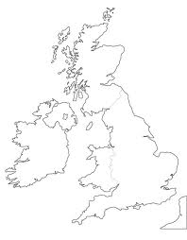
Free time
Plenty of free time - enjoy
Scotland
Lake district
Blackpool
Manchester
Nottingham
Peak district
London
Southampton
Stafford
Cornwall
Devon
North Wales
South Wales

Slide 15
Schooling – do online admission request – fast
Vehicle – do not buy from an Asian – cheap but crap
Car insurance – “Clements worldwide”

Slide 16
Thank you
QUESTIONS

